Slide 1


Cloud Native Workshop Continuous Integration and Continuous Delivery
IBM Hybrid Cloud Ecosystem
Ecosystem Labs

Slide 2
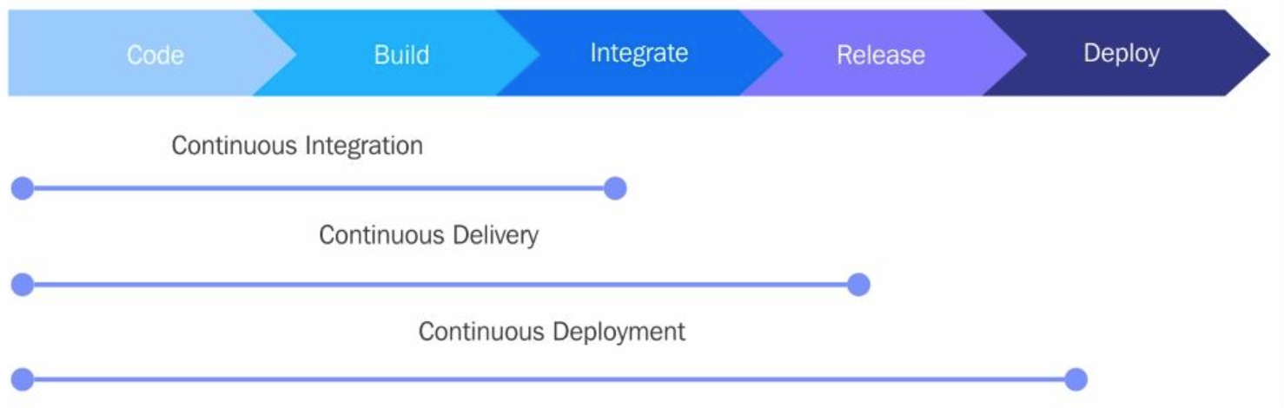
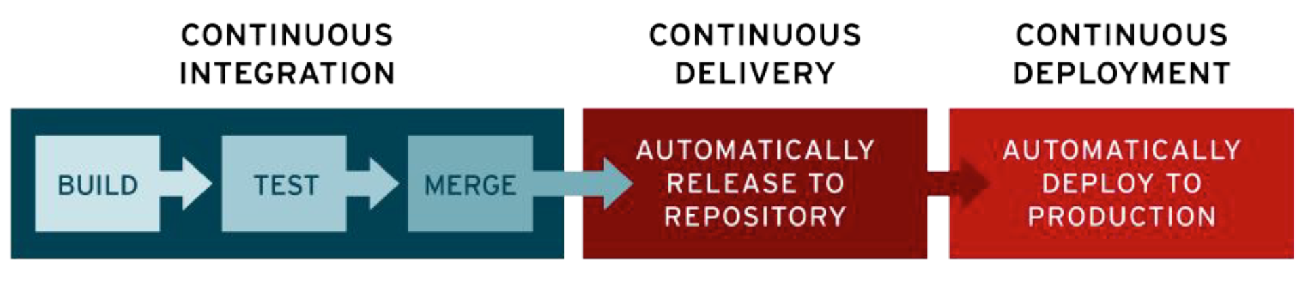
Continuous Integration, Delivery & Deployment

Slide 3





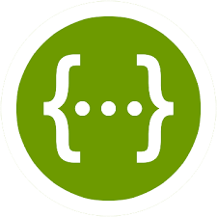





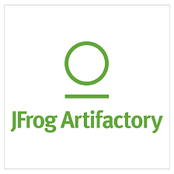



Enterprise Grade Software Development Life Cycle (SDLC)
Deploy to Clusters or Serverless
Github (Source code mgmt)
Kubernetes
Knative
IBM Hyper Protect Services (Code signing, Keep your own key - KYOK)
Local
Dev/Text
CodeReady Workspaces (Web IDE)
Zenhub (Project mgmt)
Deploy
Swagger Editor (API validation & documentation)
Code
Plan
Sysdig (View metrics and alerts)
CI
CD
Operate
Release
Argo CD (CD Release)
LogDNA (View logs)
Jenkins
(Build)
Build
Tekton (Build pipeline)
(Helpdesk)
IBM Key Protect (Certificate APIs for code signing)
(Store assets and dependencies)
Image Registry (Container Images)
Test
Measure
PagerDuty
(Analyze and test code)
Pact Testing (Test microservice contracts)
Jaeger (Container Images)
NPS
3

Slide 4

DevSecOps provides the consistent path to production from any starting point in your cloud-native development journey
Management
Runtime Platform
Cloud-Native Applications
Cloud native approach – Shift Left
ArgoCD
GitOps
WebSphere Middleware Applications
Application Code
Build
Distribute
Deploy
GitOps
Advanced Cluster Management
Cloud-Foundry Applications
DevSec(Comp)Ops
Multi Cloud Manager
Preventive controls & auto-remediation
.Net Applications
Edge Application Manager
Built-in security and compliance controls
Edge Applications
Application Source
Notes:
Problems: lack of end-to-end application visibility, and security control. Security handled at runtime by detect and react. Production impact – availability, resiliency. Velocity impact.
Limited in the problems we look at. For instance, we are missing checking the connections between the components, i.e. looking at single image.
Second, security and compliance is still a detect and react/remediate process, which leads to problems with resiliency of the application.

Slide 5
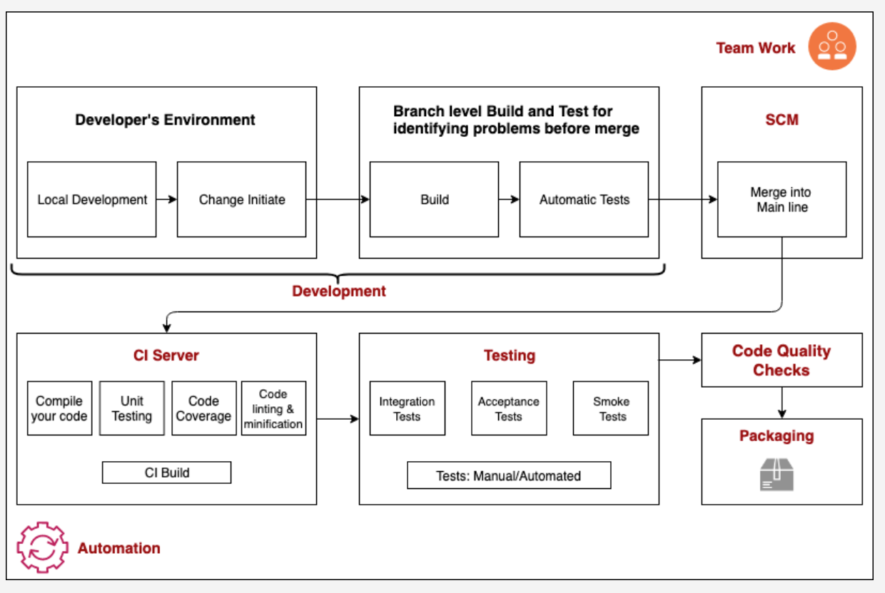
Continuous Integration

Slide 6
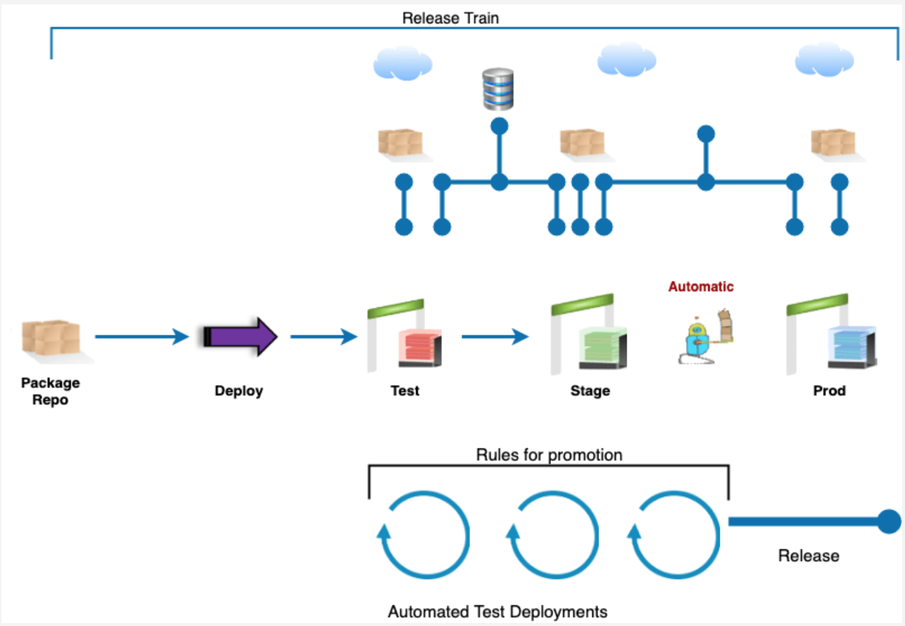
Continuous Delivery and Deployment

Slide 7
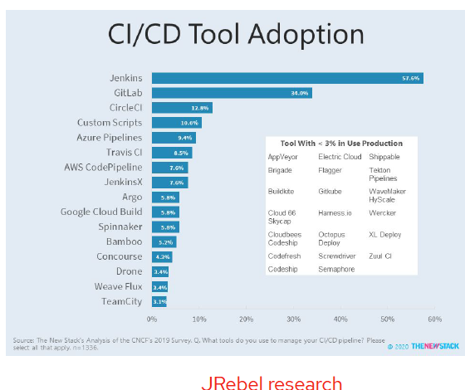


CI/CD Tools

Slide 8
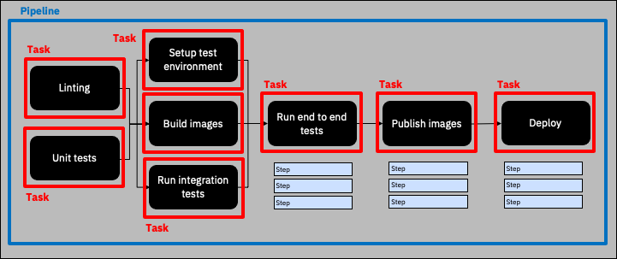
Tekton structure

Slide 9
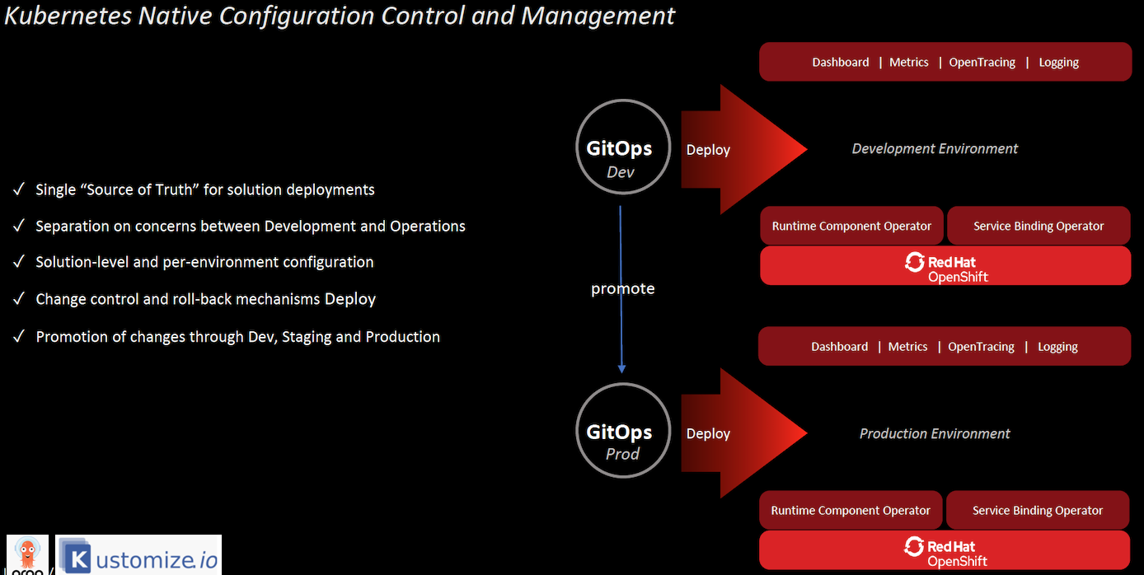
GitOps

Slide 10
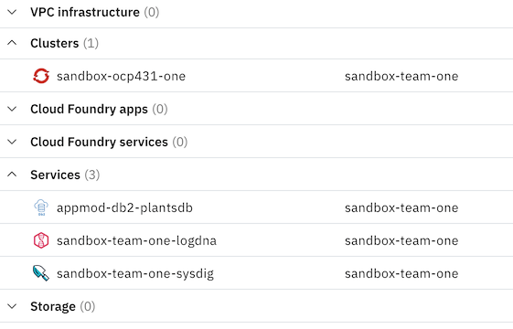
Platform

Slide 11
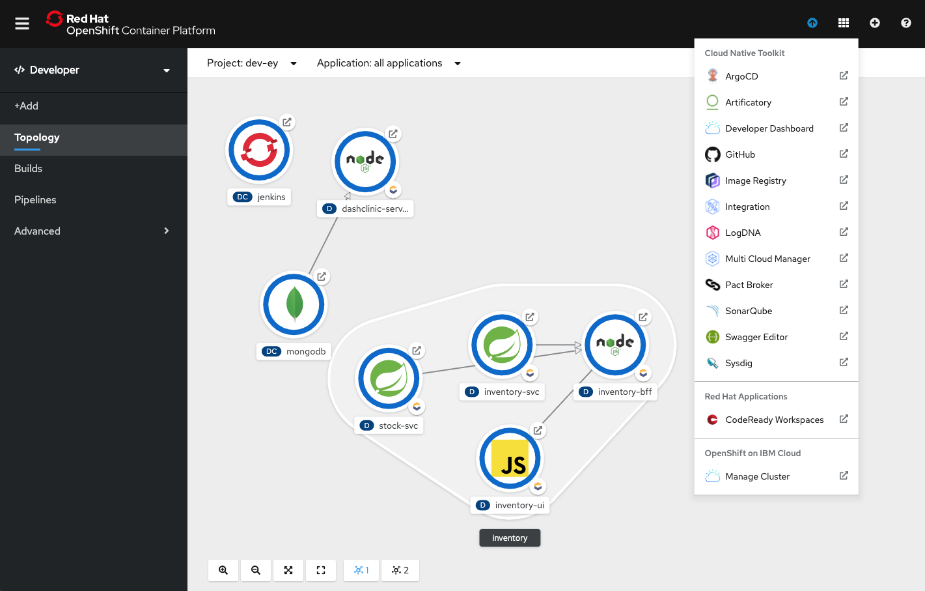
Red Hat OpenShift 4.6 Developer Experience with Enterprise Sandbox
Developer use native experience of OCP Developer Perspective
Integrated with Cloud Native Toolkit Tools
Integration with Cloud Pak
They follow the GSL Labs 301 Workshop/Activation Material
To get a full developer understanding of how to use this platform and tools
Mulit Tenant at Project/Namespace level

Slide 12
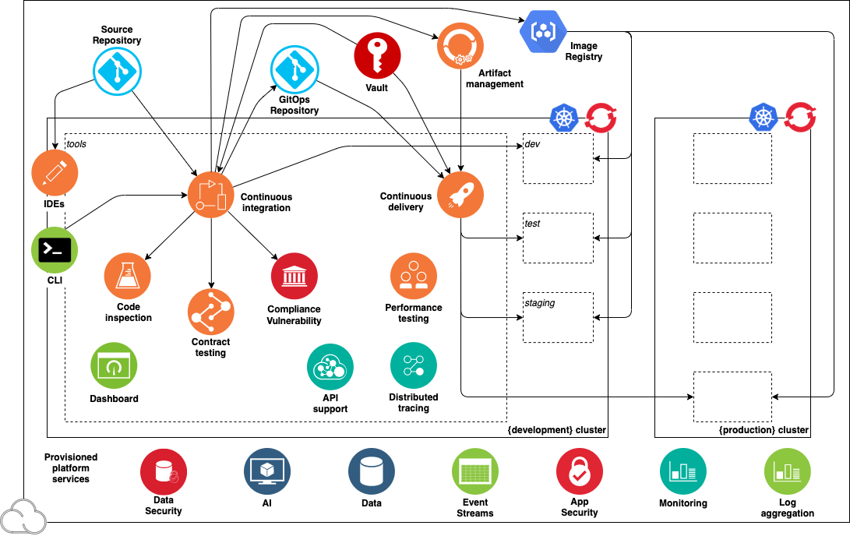
Dev Inside
In Cluster Tools focused on Dev teams needs
Platform services focused on Ops and SRE
Ops Outside

Slide 13
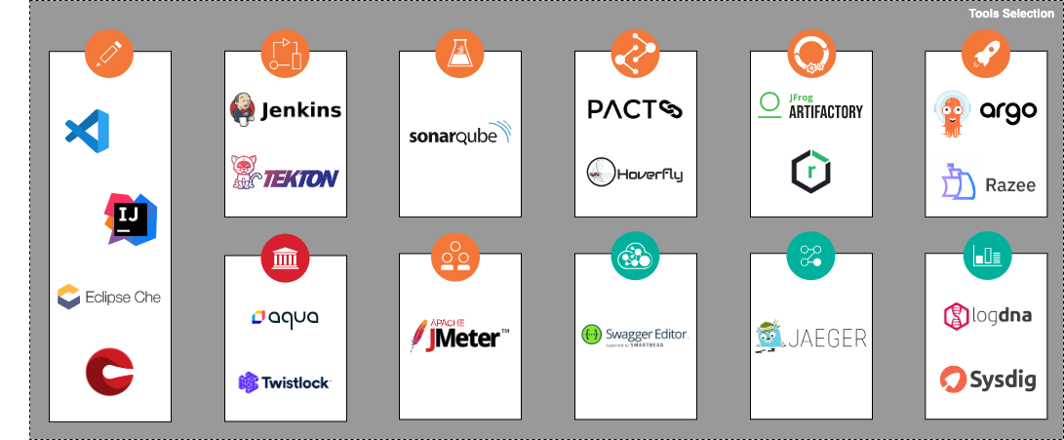
Pluggable Tools

